Slide 1
Mini Project
Guidelines

Slide 2
Purpose
To understand Embedded Systems theory better than learning without doing projects.

Slide 3
Plan A
Other
Plans

Slide 4
Plan A - Overview
Use Keil Software Evaluation Version.
Write small C programs and/or
Understand a large C program, “Measure”

Slide 5
Plan A- (Pending) Issues
Limitation of the Keil Evaluation Tool Version.
But you can download the tool to your Windows PC.

Slide 6
Plan A - Success Strategy
Step-by-Step Introduction in the class to do a project using Keil MicroVision Software

Slide 7
Other Plans
EdX Course

Slide 8
Other Plans
Free RTOS

Slide 9
Other Plans
Simple Scalar Processor Simulator

Slide 10
Other Plans
SystemC

Slide 11
Special Function Registers
A Closer Look

Slide 12
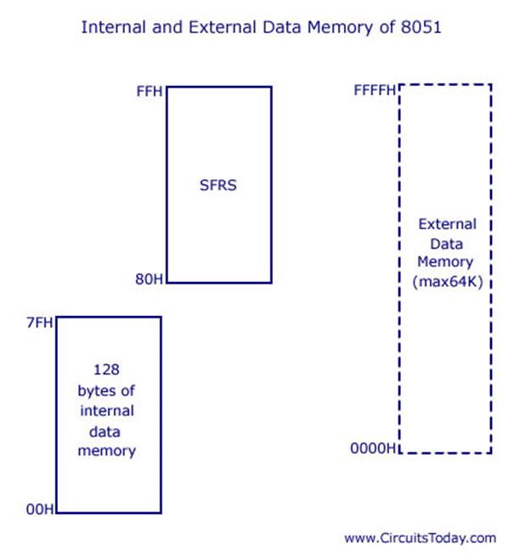

Slide 13
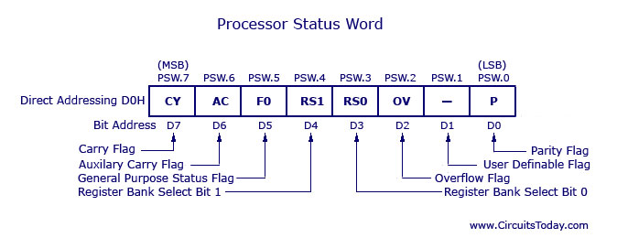

Slide 14
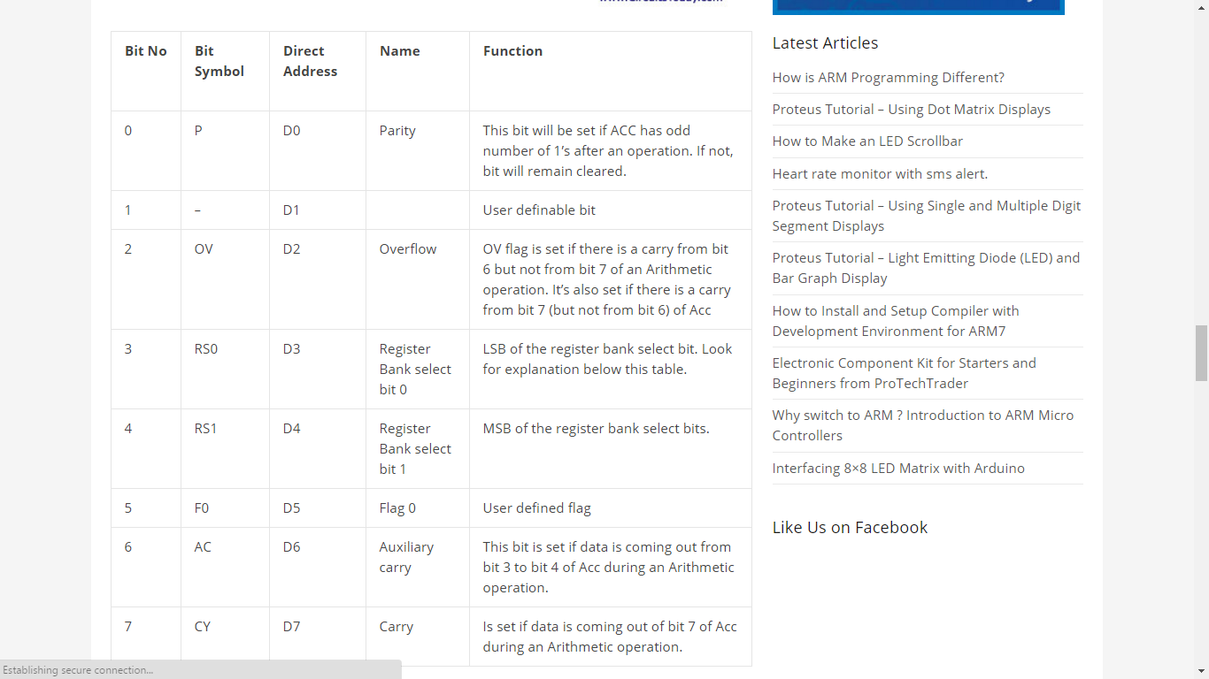

Slide 16
